Slide 1
Project Title: CSEDU_OneShare Application
Team Members: Jannatul Ferdousi (08)
Sumaiya Tabassum (29)

Slide 2
Objective:
A user-friendly sharing application is created that allows users to sign up and communicate with each other if they are in the same local area network .
The key features of this project are:
User Registration and Login
Peer to Peer Chat Interface
Faster and large file transmission
Lightweight software to use

Slide 3
Interestingness of the project:
User Interaction
Peer to Peer Communication
File transmission
Scalability
Notes:
User Interaction: Creating a seamless login experience enhances user engagement and satisfaction.
Scalability: The project provides opportunities to explore scalable design principles, making it a great learning experience for handling larger user bases.

Slide 4
Design Decisions and Principles
Modularity: Each component of the application (e.g., login, chat interface) is designed as a separate module.
Open/Closed Principle: The design is open for extension (adding new features) but closed for modification (existing functionality remains unaffected).
Single Responsibility Principle: Each class has a single responsibility, making the codebase easier to manage and extend.

Slide 5
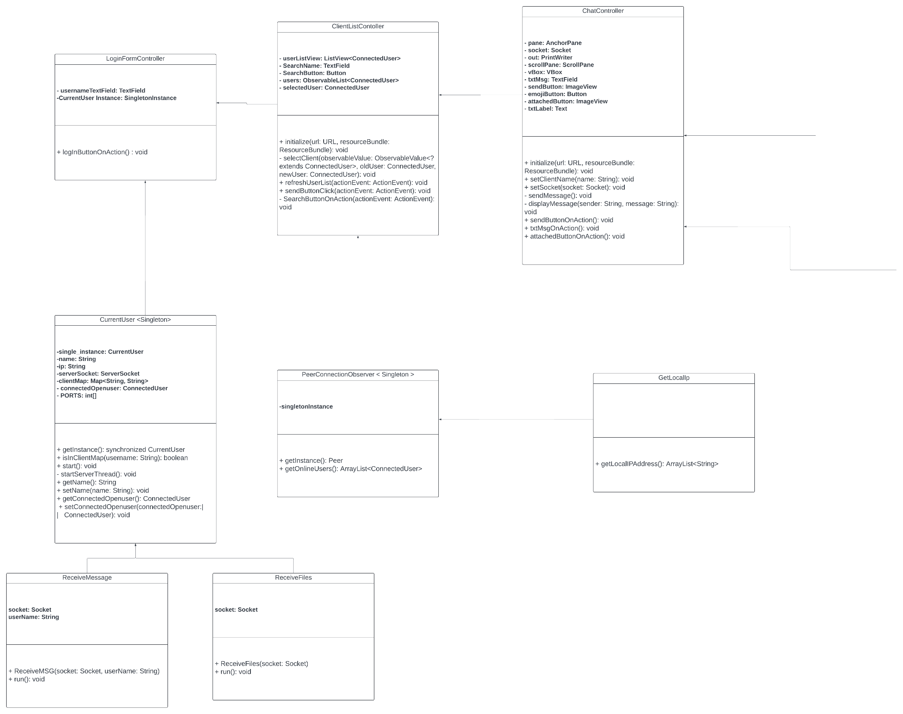
UML
Diagram

Slide 6
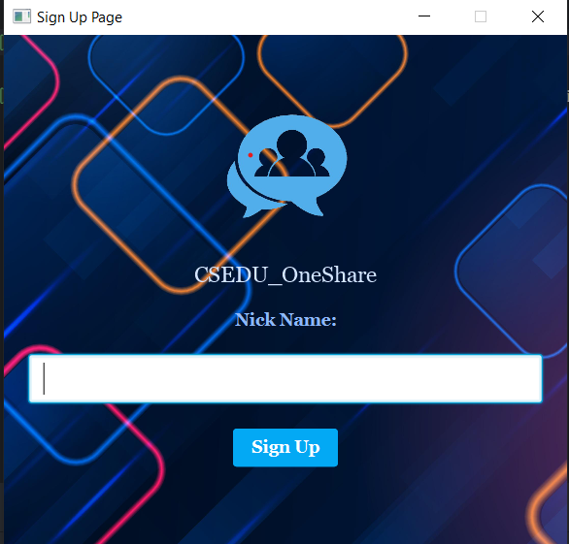
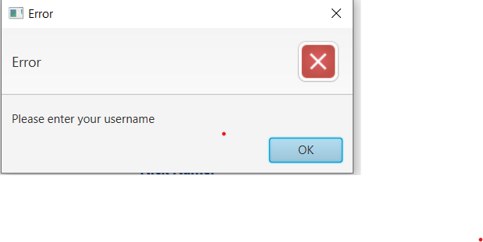
Project Modulation:
This sharing Application Project can be divided into several
parts.
Application Launch
Start: User starts the application.
Initialize Main Stage: The login interface is displayed.
User Login
Enter Username: User enters their username.
Sign Up: Username is verified, and configurations are set.
Set Name: CurrentUser instance is updated with the username.

Slide 7
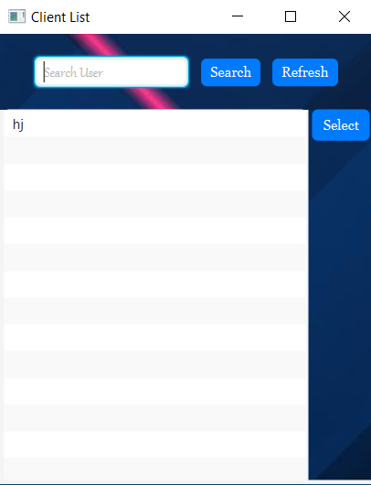
Client List Operation
Initialization: The initialize method populates theListView with the list of connected users when the controller is first loaded.
User Selection: The selectClient method sets the selectedUser based on the user's selection from the list.
Refresh Action: The refreshUserList method refreshes the list of connected users.
Search Action: The SearchButtonOnAction method filters the list of users based on the search query.
Send Button Action: The sendButtonClick method initiates a new chat session with the selected user by opening a new chat window.

Slide 8
Establishing Connection
Server Socket Initialization: Application attempts to establish a ServerSocket.
Start Listening: CurrentUser starts a server thread to listen for incoming connections.
Select User: User selects another user from the client list.
Establish Socket Connection: Socket connection is established to the selected user's server.

Slide 9
Chat Interface Initialization
Load UI Components: FXML file is loaded, and UI components are initialized.
Set Client Information: Client name is displayed in the chat interface.

Slide 10
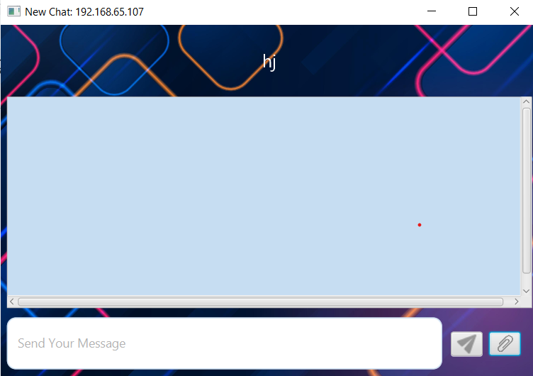
Sending Messages
Type Message: User types a message in the TextField.
Send Message: User presses Enter or clicks the send button.
Transmit Message: sendMessage method sends the message via socket.
Display Message: Message is displayed in the chat interface.

Slide 11
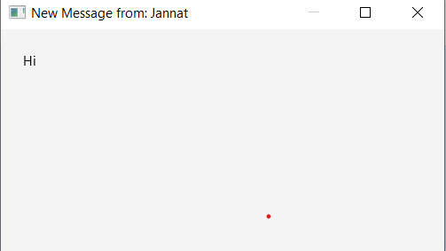
Receiving Messages
Listen for Messages: ReceiveMSG thread listens for incoming messages.
Display Notification: Notification window displays the received message.

Slide 12
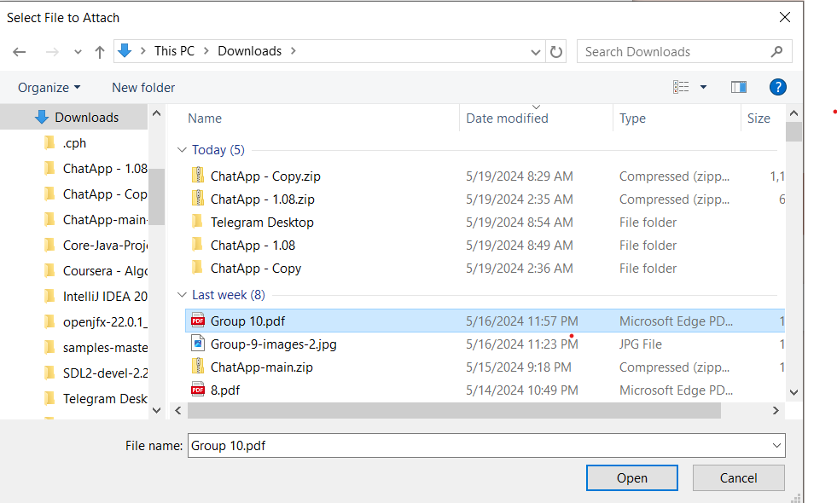
File Transfer
Initiate File Transfer: User clicks attach button.
Open File Chooser: File chooser is displayed, and user selects a file.
Send File: File metadata and content are sent via socket.

Slide 13
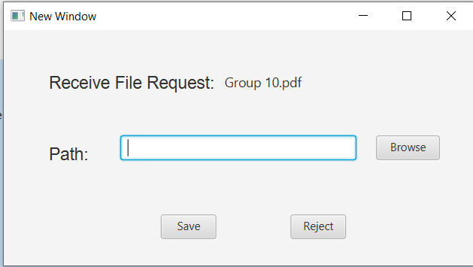
File Transfer
Receive File Transfer Request: ReceiveFiles thread handles incoming file transfer request.
Display File Share Request UI: User can accept or reject the file transfer.
Save File: If accepted, file is saved to specified directory.

Slide 14
UI Updates and Notifications
Display Messages: Messages are displayed in VBox inside ScrollPane.
Style Messages: Messages are styled using HBox and TextFlow.
Display File Transfer Status: Status of file transfers is displayed in chat interface.
Show Notifications: Notifications for incoming messages and file transfers.

Slide 15
Future Improvement

Slide 16
Thank You

